Slide 1
Welcome to my project on the development of the university of niit website

Slide 2
Designed, and Presented by: Saba Ayodele

Slide 3
certificate
This is to certify that this project work titled
University of NIIT embodies the project done by Saba Ayodele in partial fulfilment of the course requirement in NIIT .

Slide 4
THE NEXT SET OF SLIDES CONTAIN IMAGES OF THE PAGES OF THE WEBSITE DEVELOPED.

Slide 5

HOME PAGE

Slide 6
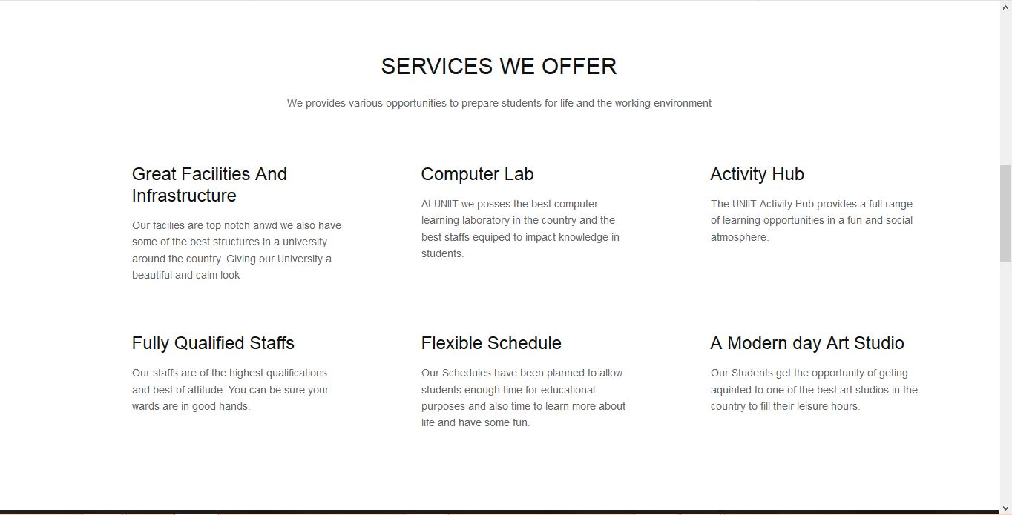
HOME PAGE

Slide 7
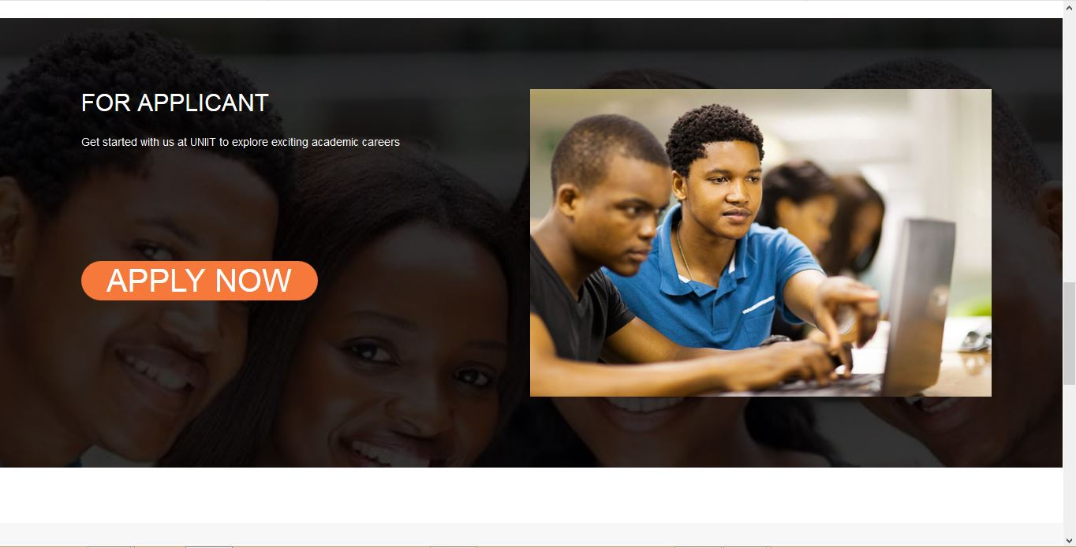
HOME PAGE

Slide 8
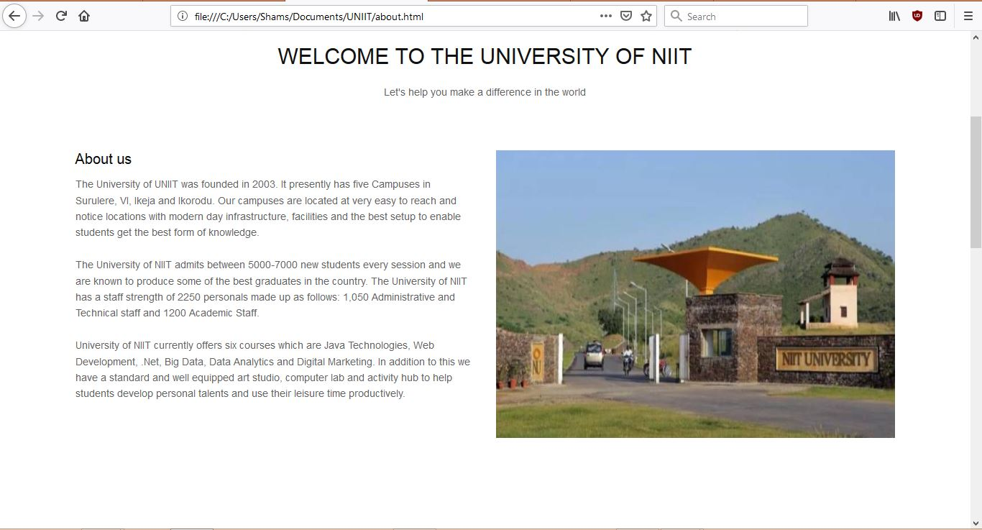
ABOUT PAGE

Slide 9
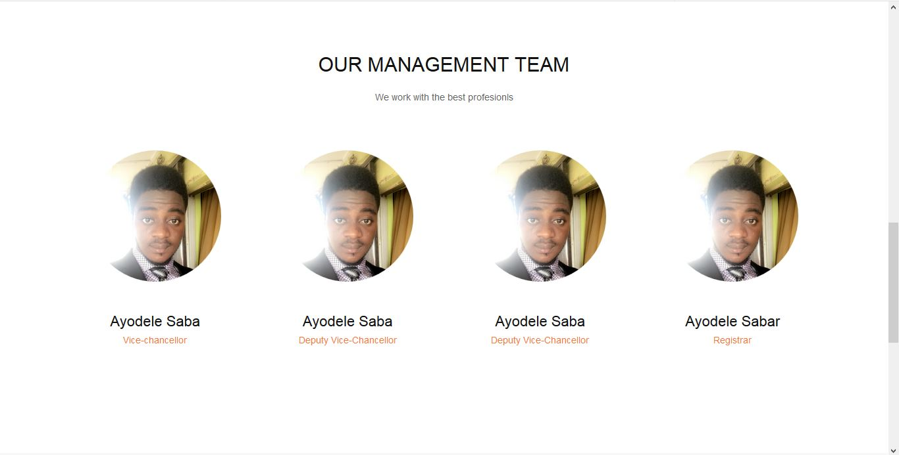
ABOUT PAGE

Slide 10
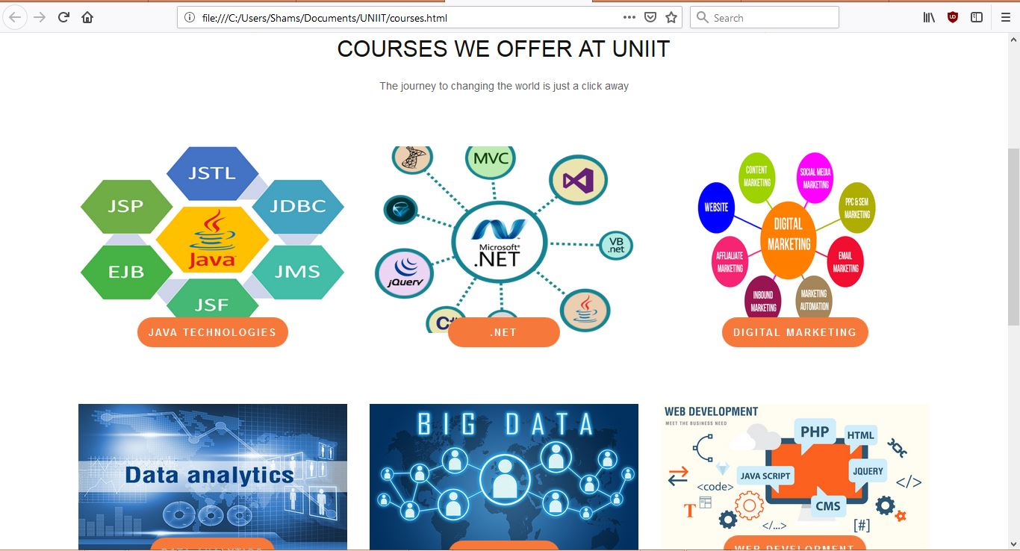
COURSES PAGE

Slide 11
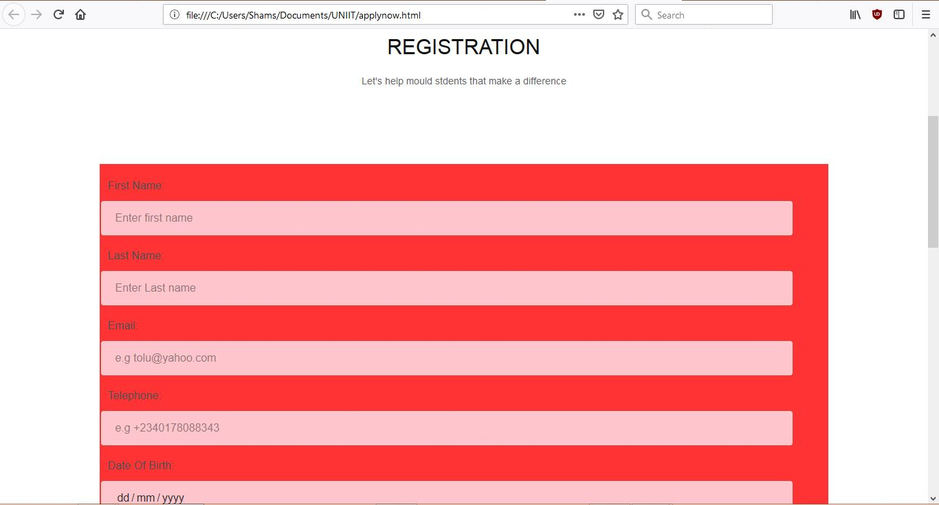
APPLY NOW PAGE

Slide 12
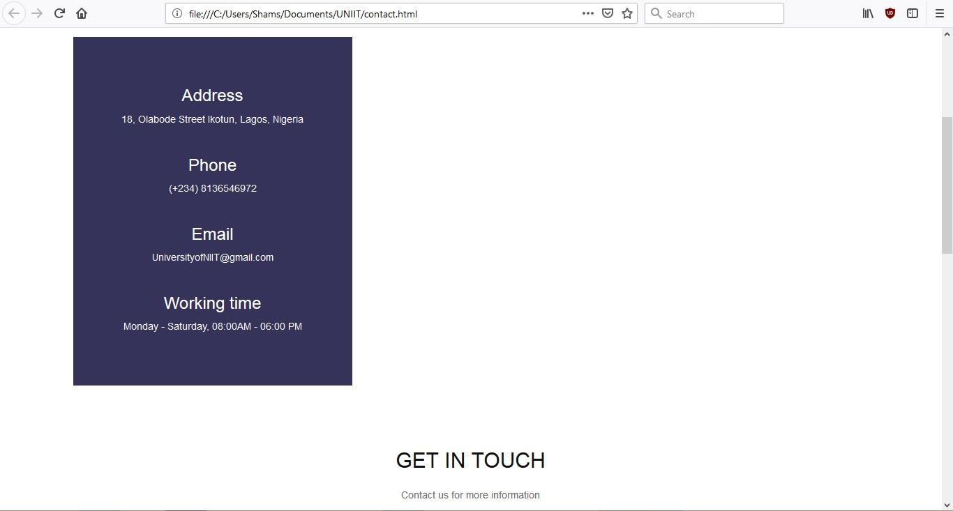
CONTACT US PAGE

Slide 13
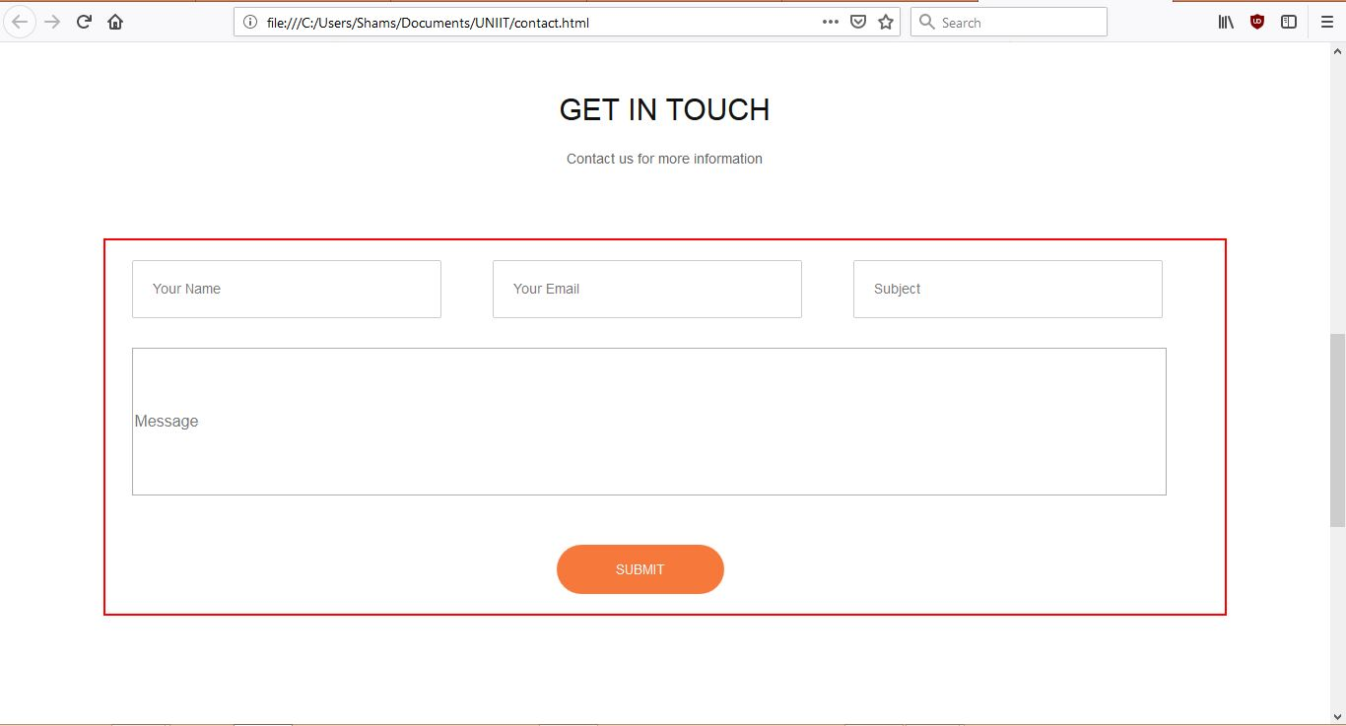
CONTACT US PAGE

Slide 14
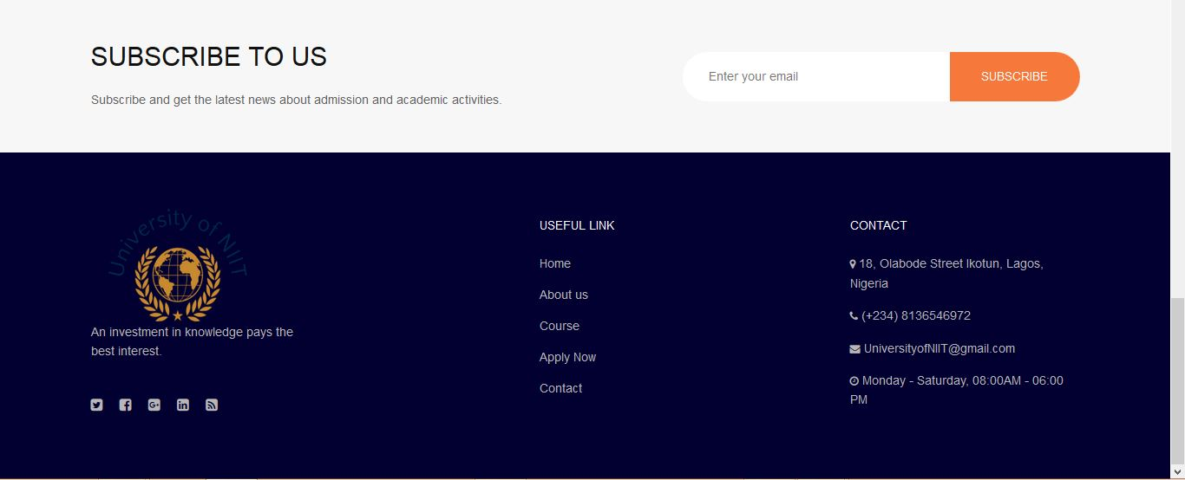
FOOTER SECTION

Slide 15
challenges
Deciding on a frame model of the web page.
Implementing Styling and Scripting designs to fit the project work.
3. Documentation.

Slide 16
Thank you.

